Slide 1
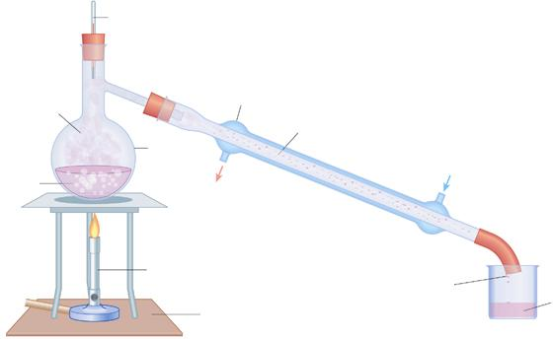
Distillation
7F Reactions with oxygen – What is burning?
Unit 1
Lesson 5

Slide 2
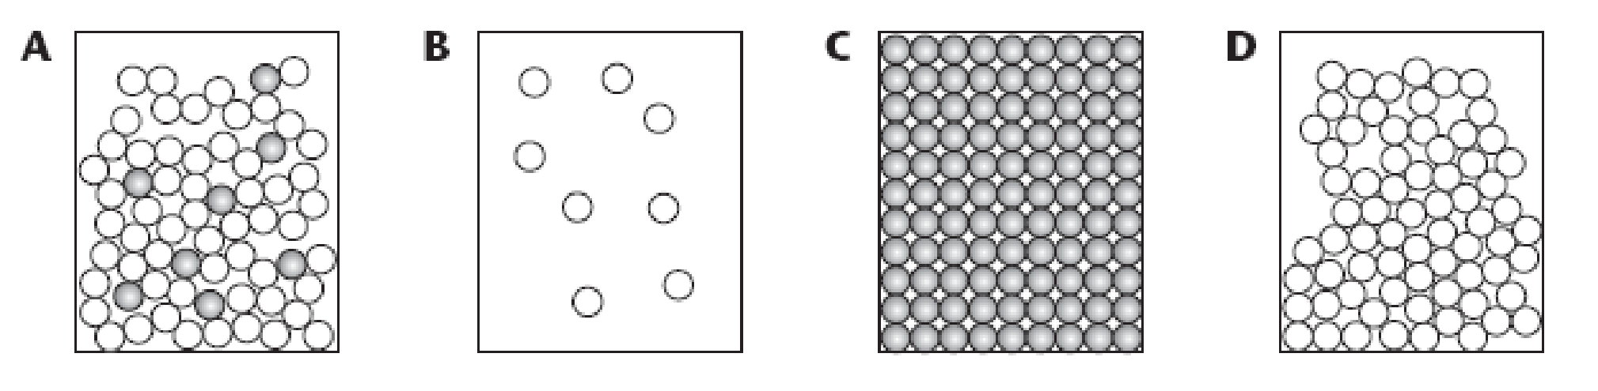
Starter: question
Q: How could you separate the water from the salt solution? i.e. only get the water unlike last lesson.

Slide 3
Today’s Aim
7F Reactions with oxygen – What is burning?
Unit 1
Lesson 5
By the end of this lesson I will be able to describe the techniques of…
simple distillation
fractional distillation
…as methods for separation of mixtures

Slide 4
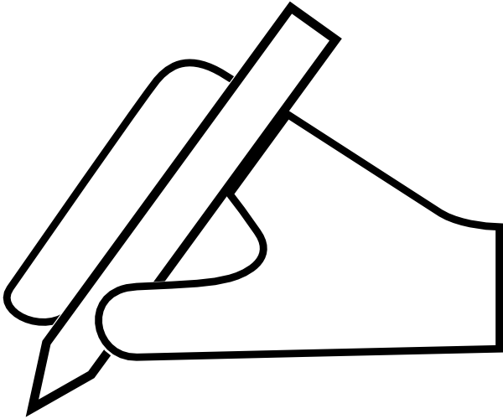

7H Separation techniques – Distillation
Distillation - notes on page 19
The best method to separate and collect the solvent from a solution is distillation.
Distillation involves three stages:
boiling
cooling & condensing
collecting

Slide 5

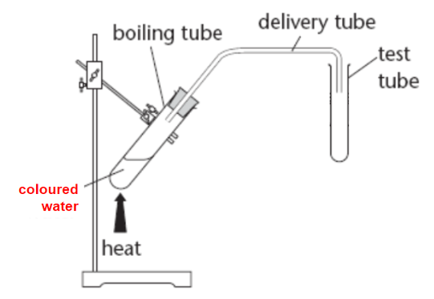
Distillation
(Use a test tube holder to hold the test tube in place around the opening of the delivery tube.)
the winning team collects the most pure water here
Notes:
Possible method:
Add a small volume of ink solution to a boiling tube and clamp it in place.
Heat the tube using a Bunsen burner, reducing the flame as necessary to achieve gentle simmering. *Do not over- boil, your liquid will enter the tube and contaminate your final product*
When you have collect a sample of pure water, turn the Bunsen burner off.
Allow apparatus to cool before tidying up.

Slide 6
Distillation
How can we improve the method of distillation to increase the volume of pure water that we can collect?

Slide 7
7H Separation techniques – Distillation
Simple Distillation
thermometer
liquid boils off
condenser
gas cools and condenses
flask with mixture
water in
water out
heat
liquid is collected
pure liquid
heat mat

Slide 8
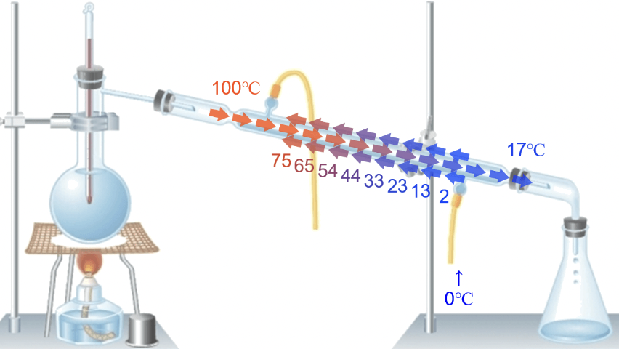
7H Separation techniques – Distillation
Simple Distillation
2
Note that the tap water flows countercurrent to gas.

Slide 9
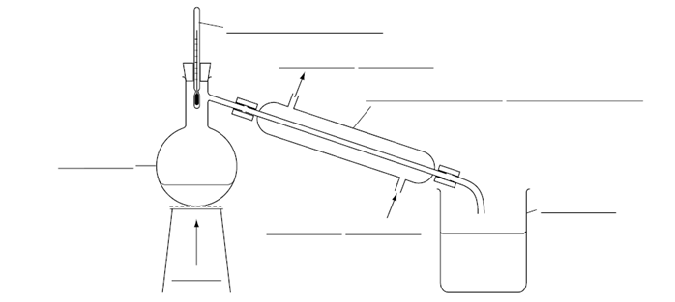
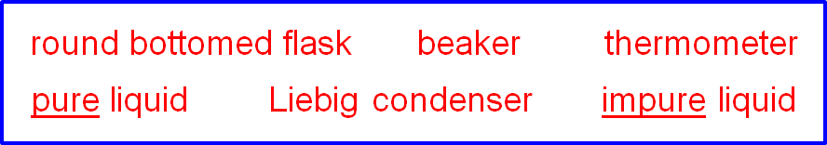
Simple Distillation Apparatus - copy onto page 19
water out
cold water in

Slide 10
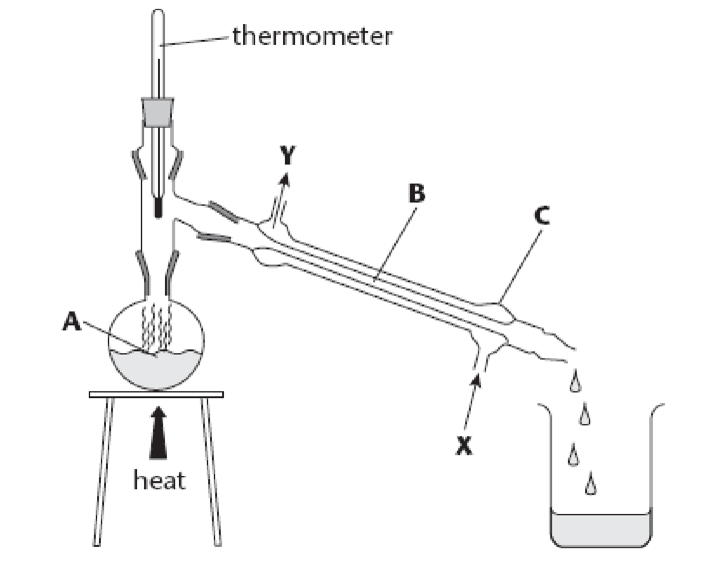
Simple Distillation
Arrow A is pointing to the place where .................... happens.
At point B the hot vapour is cooling back to a liquid. This process is called ..................
……. .…… goes into the distillation apparatus at point X and comes out again at point Y
Why is this substance necessary?

Slide 11
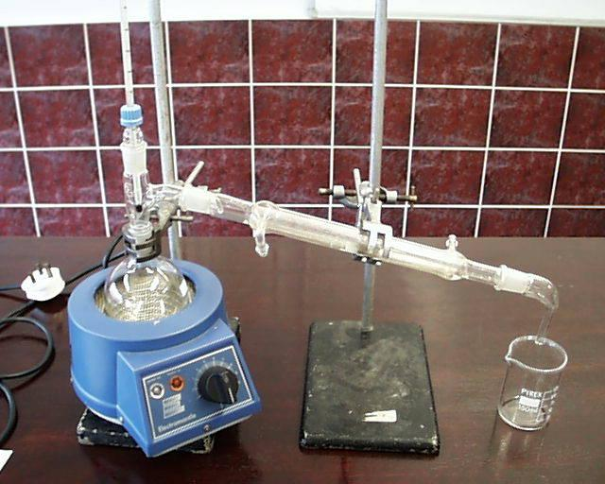
Why might heating without a flame be necessary?
thermometer
condenser
electric
heater
collection
beaker

Slide 12
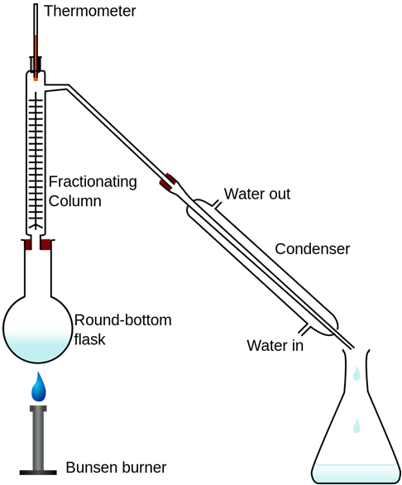
Fractional Distillation
is a method used to separate liquids with different boiling points. For example ethanol (76^{०}C) and water (100^{०}C).
heat
Notes:
Note that we will learn about fractional distillation again in Y11. This will be focused on the fractional distillation of crude oil. However, for Y10, you don’t need to know about crude oil yet.

Slide 13
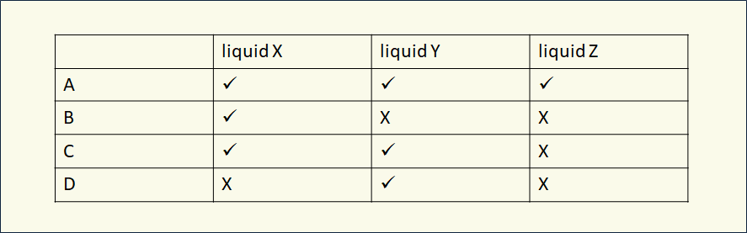
Plenary: multiple choice question
A mixture of three liquids needs separating. The expected temperature range for collecting each liquid in the distillate is shown below.
liquid X: 40°C-100°C liquid Y: 120°C-160°C liquid Z: 180°C -200°C
The mixture was added to the distillation apparatus and was heated quickly to 150°C. Select the row of the table that shows what would be collected in the distillate.
Notes:
From: www.bestevidencescienceteaching.org

Slide 14
What you need to know
Topic 1
Lesson 5
Syllabus Content
1.10 describe these experimental techniques for the separation of mixtures:
• simple distillation
• fractional distillation
My Learning

